Slide 1
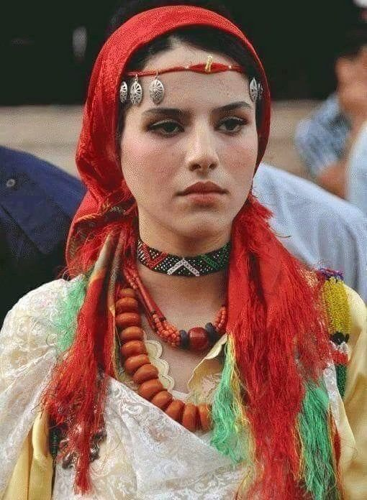


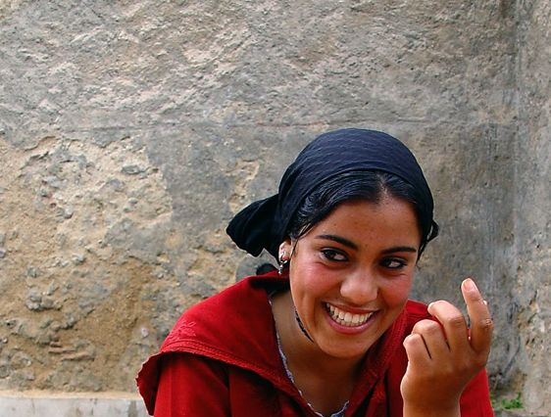
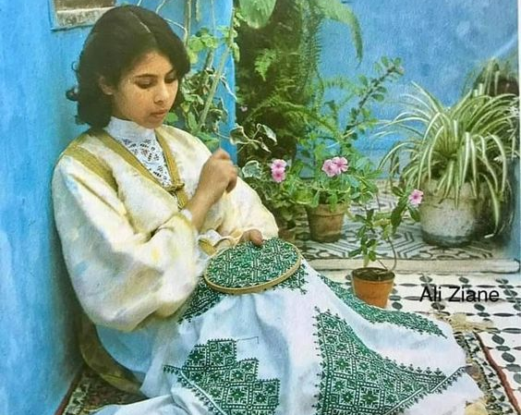

Breathe AI

Slide 2
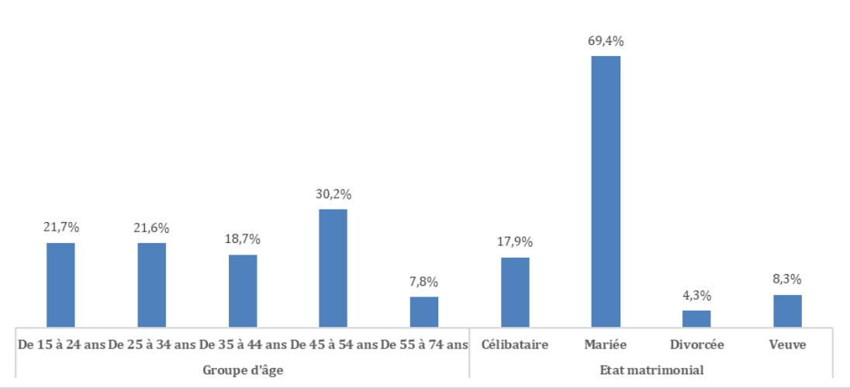
Company Culture
2024
Distribution of reference women according to age groups and marital status

Slide 3



☼ Matkhafich
BREATHE AI
PREVALENCE OF VIOLENCE
CULTURAL AND SOCIAL STIGMA
LIMITED ACCESS TO RESOURCES
In rural and underserved urban areas, there are often limited services available for women experiencing violence. This includes a shortage of legal assistance, counseling services.
In many Moroccan communities, discussing violence and abuse is taboo. Victims often face societal judgment, shame, and ostracism if they come forward.
In rural and underserved urban areas, there are often limited services available for women experiencing violence. This includes a shortage of legal assistance, counseling services.

Slide 4
☼ Matkhafich
BREATHE AI
INTRO
Matkhafich is a chatbot assistant designed to support women in Morocco who are experiencing violence.

Slide 5
☼ Matkhafich
BREATHE AI
PSYCHOLOGICAL SUPPORT
LEGAL INFORMATION
Matkhafich provides emotional support to help women cope with the trauma of abuse.
Educates women about their rights under Moroccan law.
PRACTICAL ADVICE
Offers guidance on safety planning and accessing local resources.

Slide 6
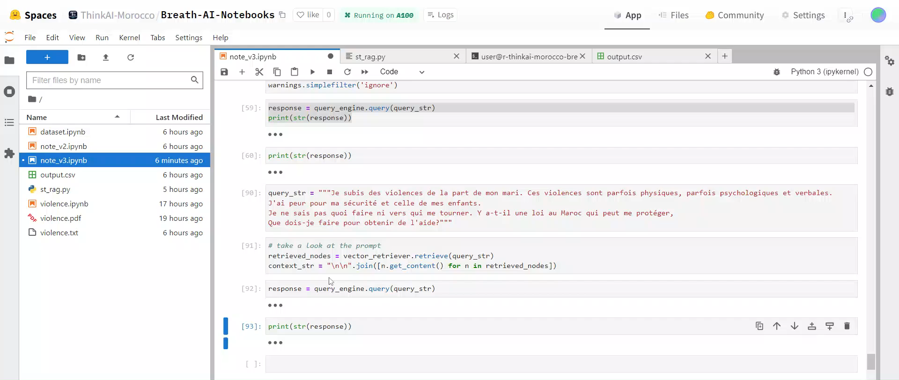

Slide 7
☼ Matkhafich
BREATHE AI
Matkhafich will be trained to understand and respond to user queries in Moroccan dialect (Darija), ensuring that conversations feel natural and culturally relevant.
MOROCCAN DIALECT INTEGRATION
DATA COLLECTION AND ANALYSIS
Matkhafich will collect anonymized data from user interactions to improve its understanding of the unique challenges and needs faced by women experiencing violence in Morocco.
we plan to enhance our offerings by introducing paid features. These additional services will be developed in collaboration with mental health care providers, ensuring high-quality and comprehensive support for our users.
BUSINESS POTENTIAL

Slide 8


Breathe AI
2024
Thank You

